Slide 1


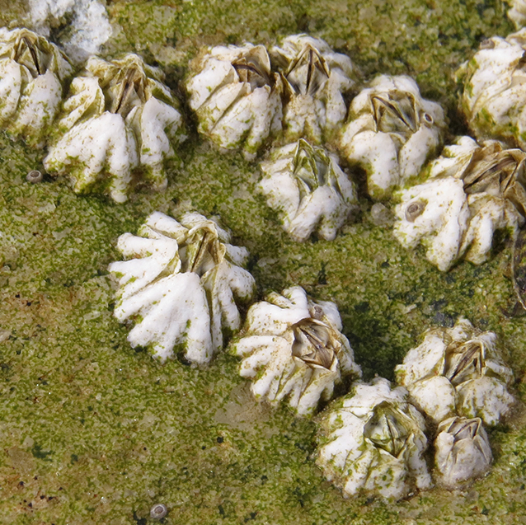
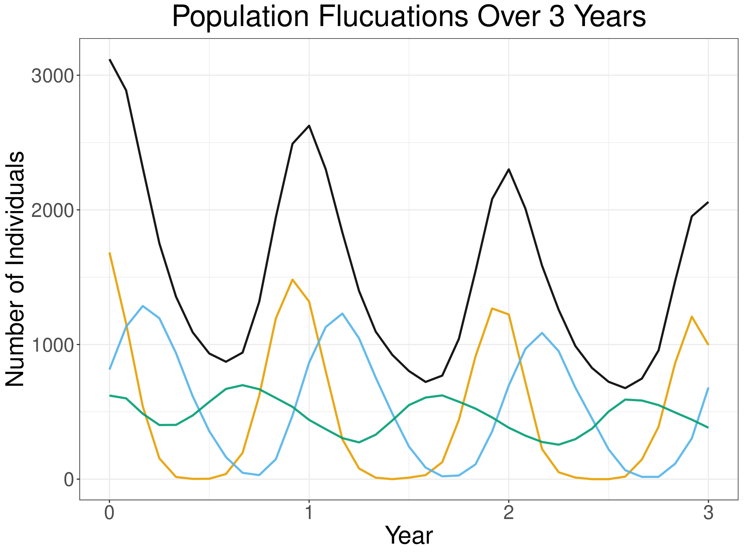
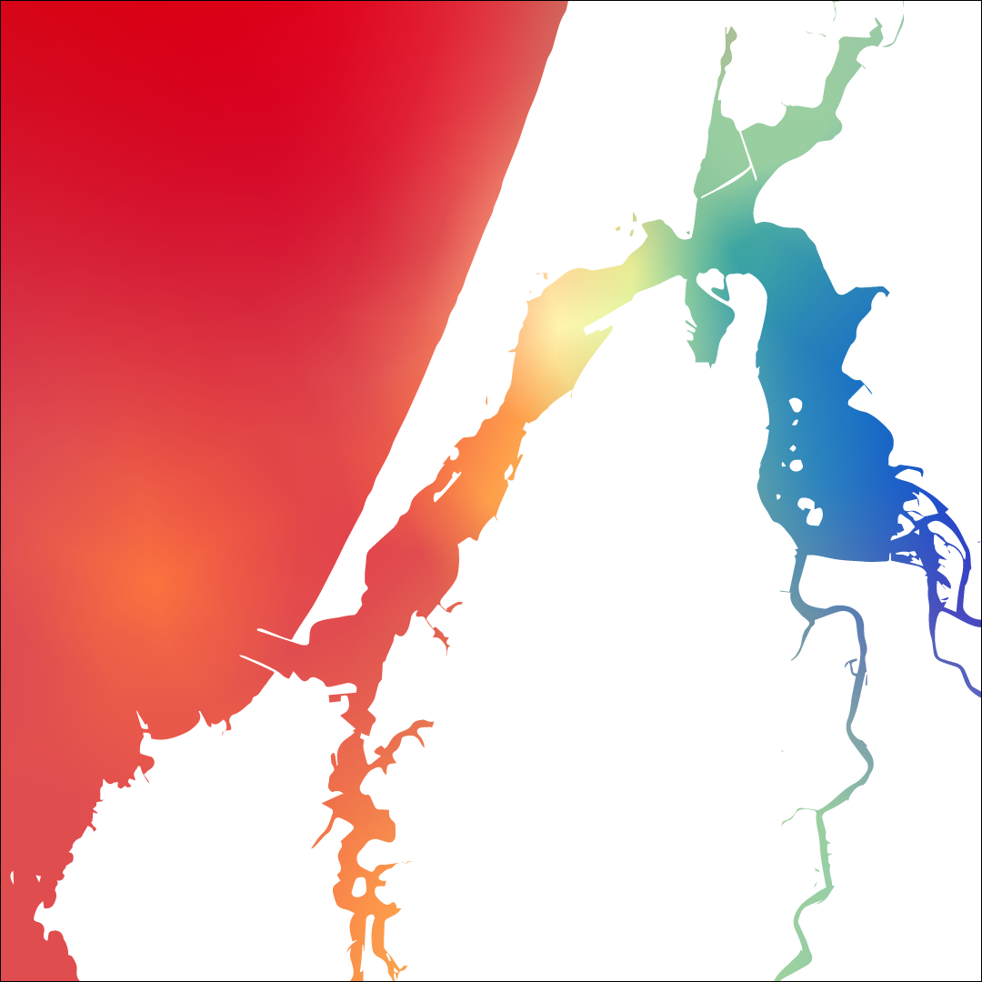

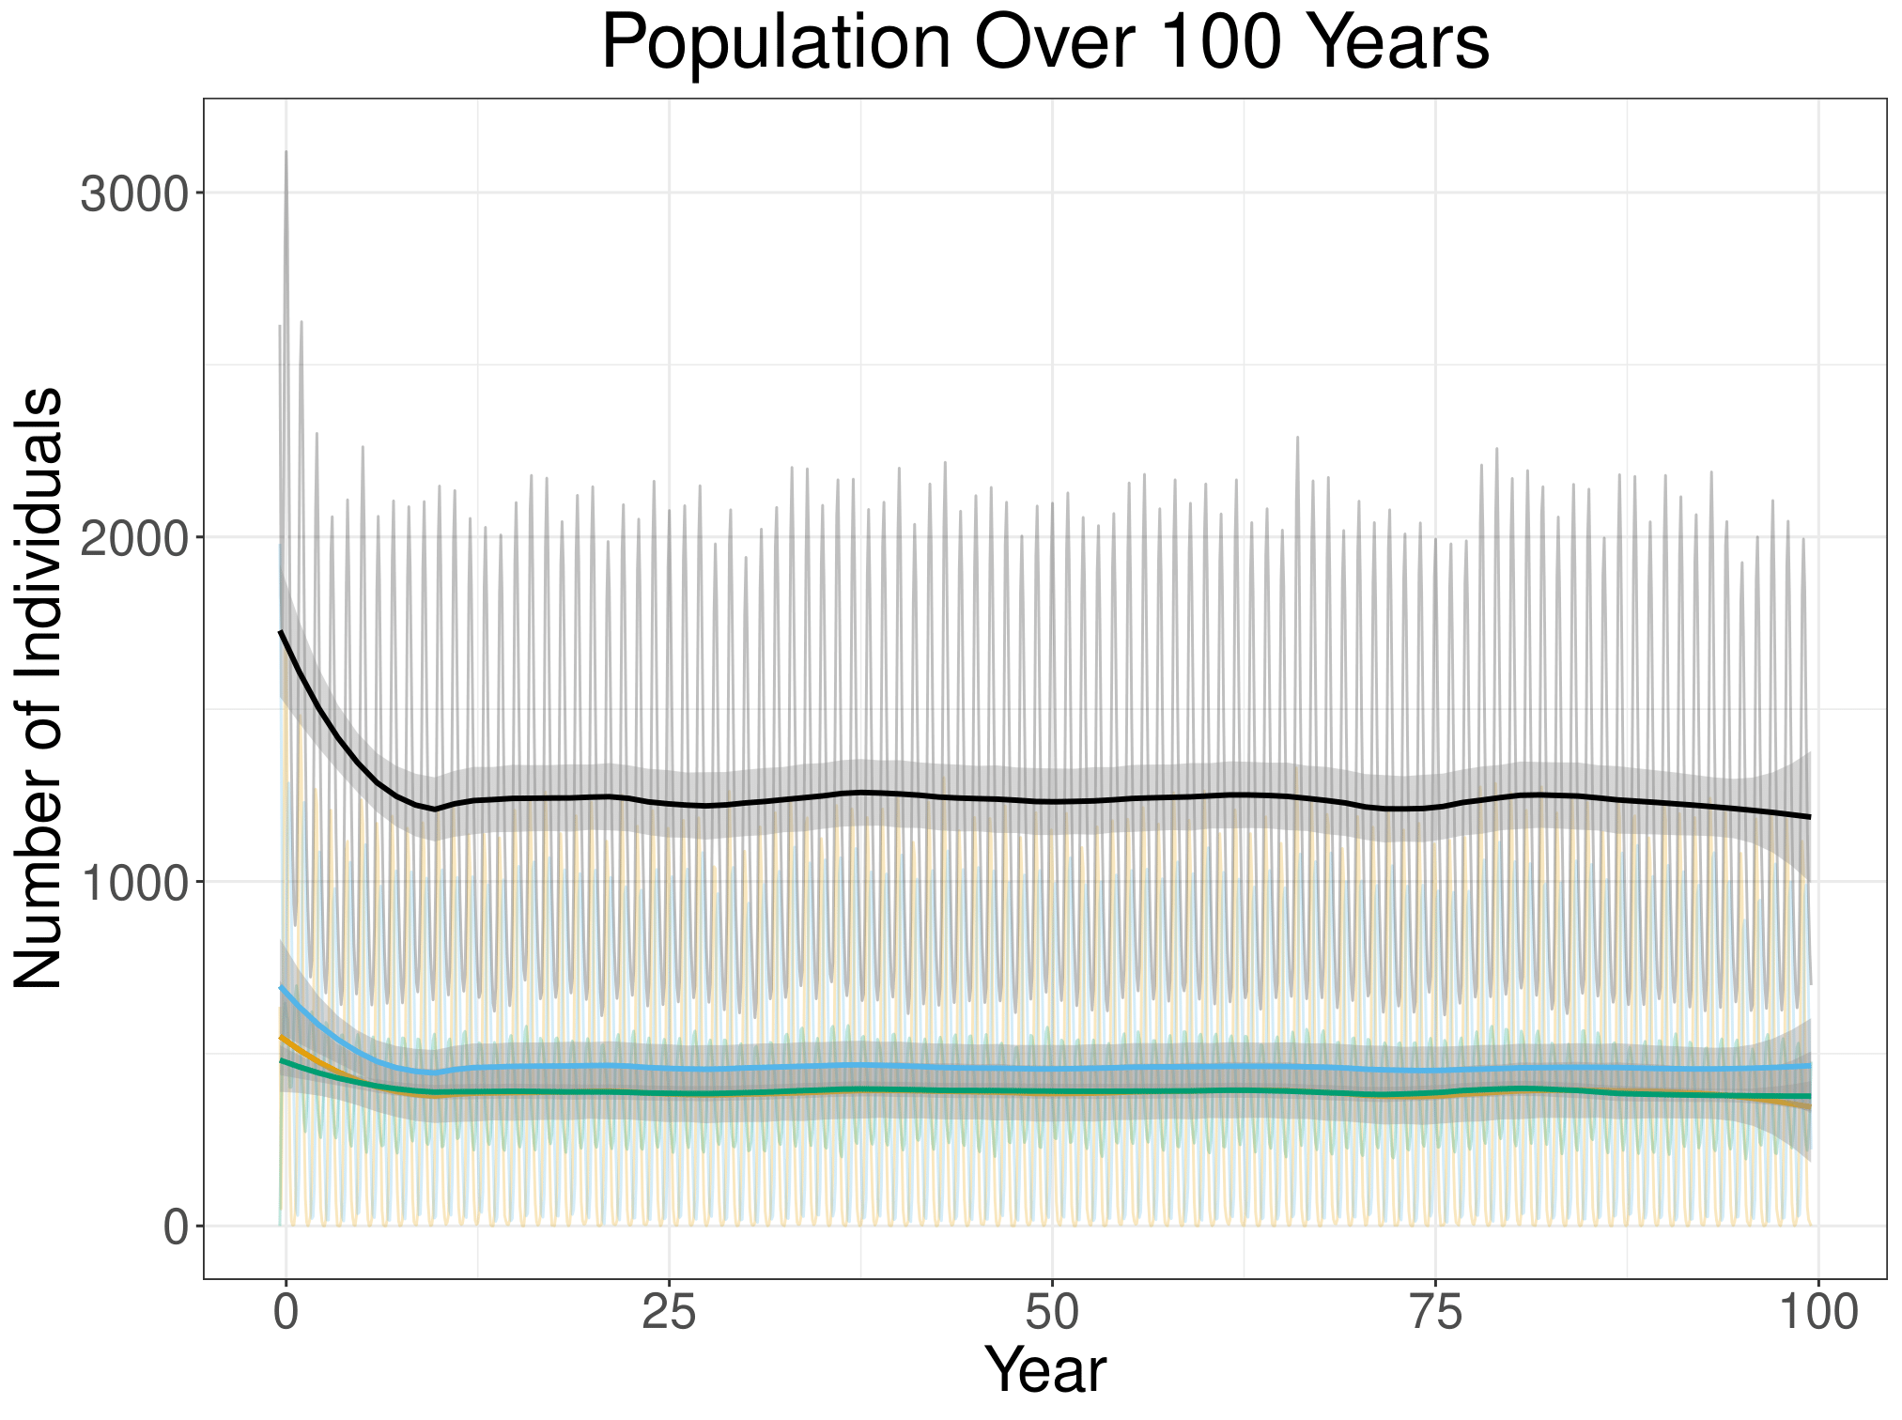
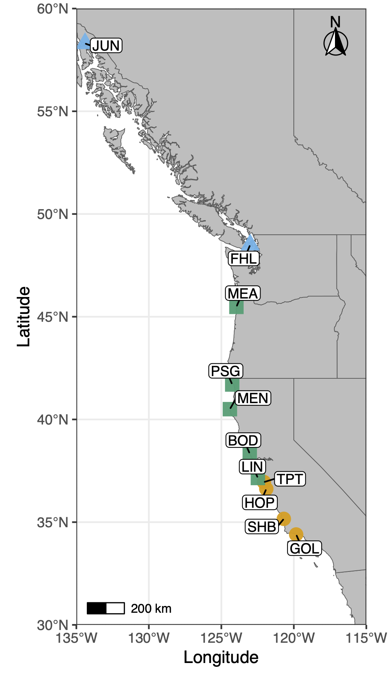
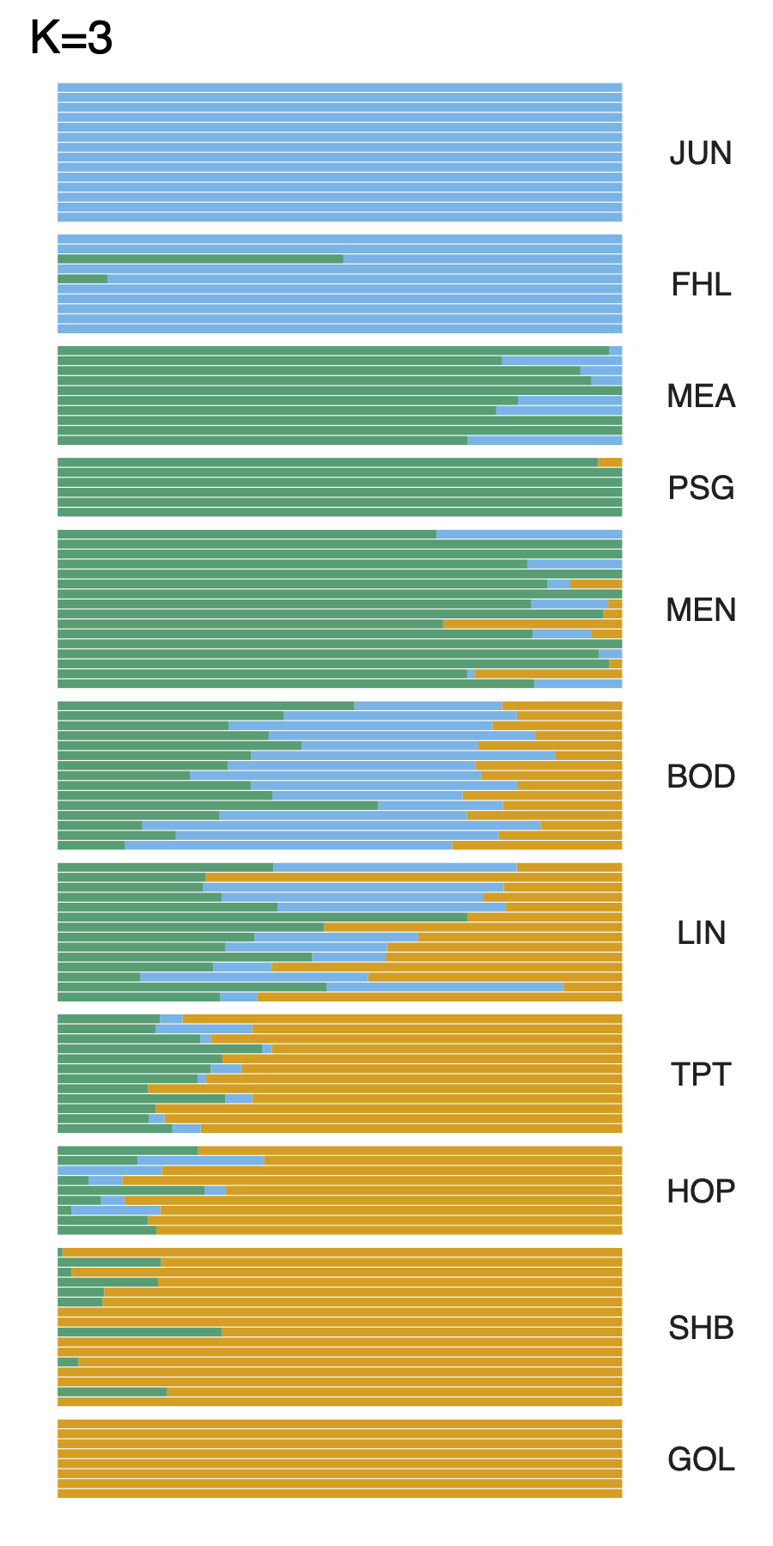
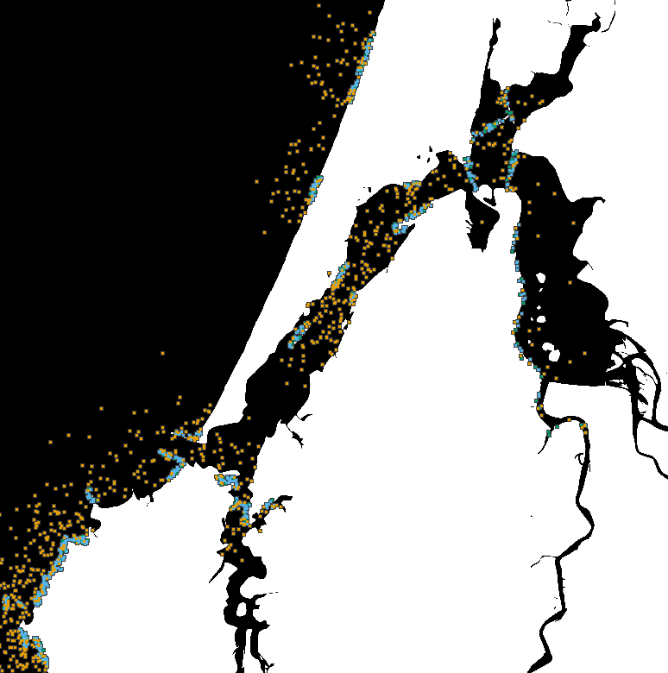
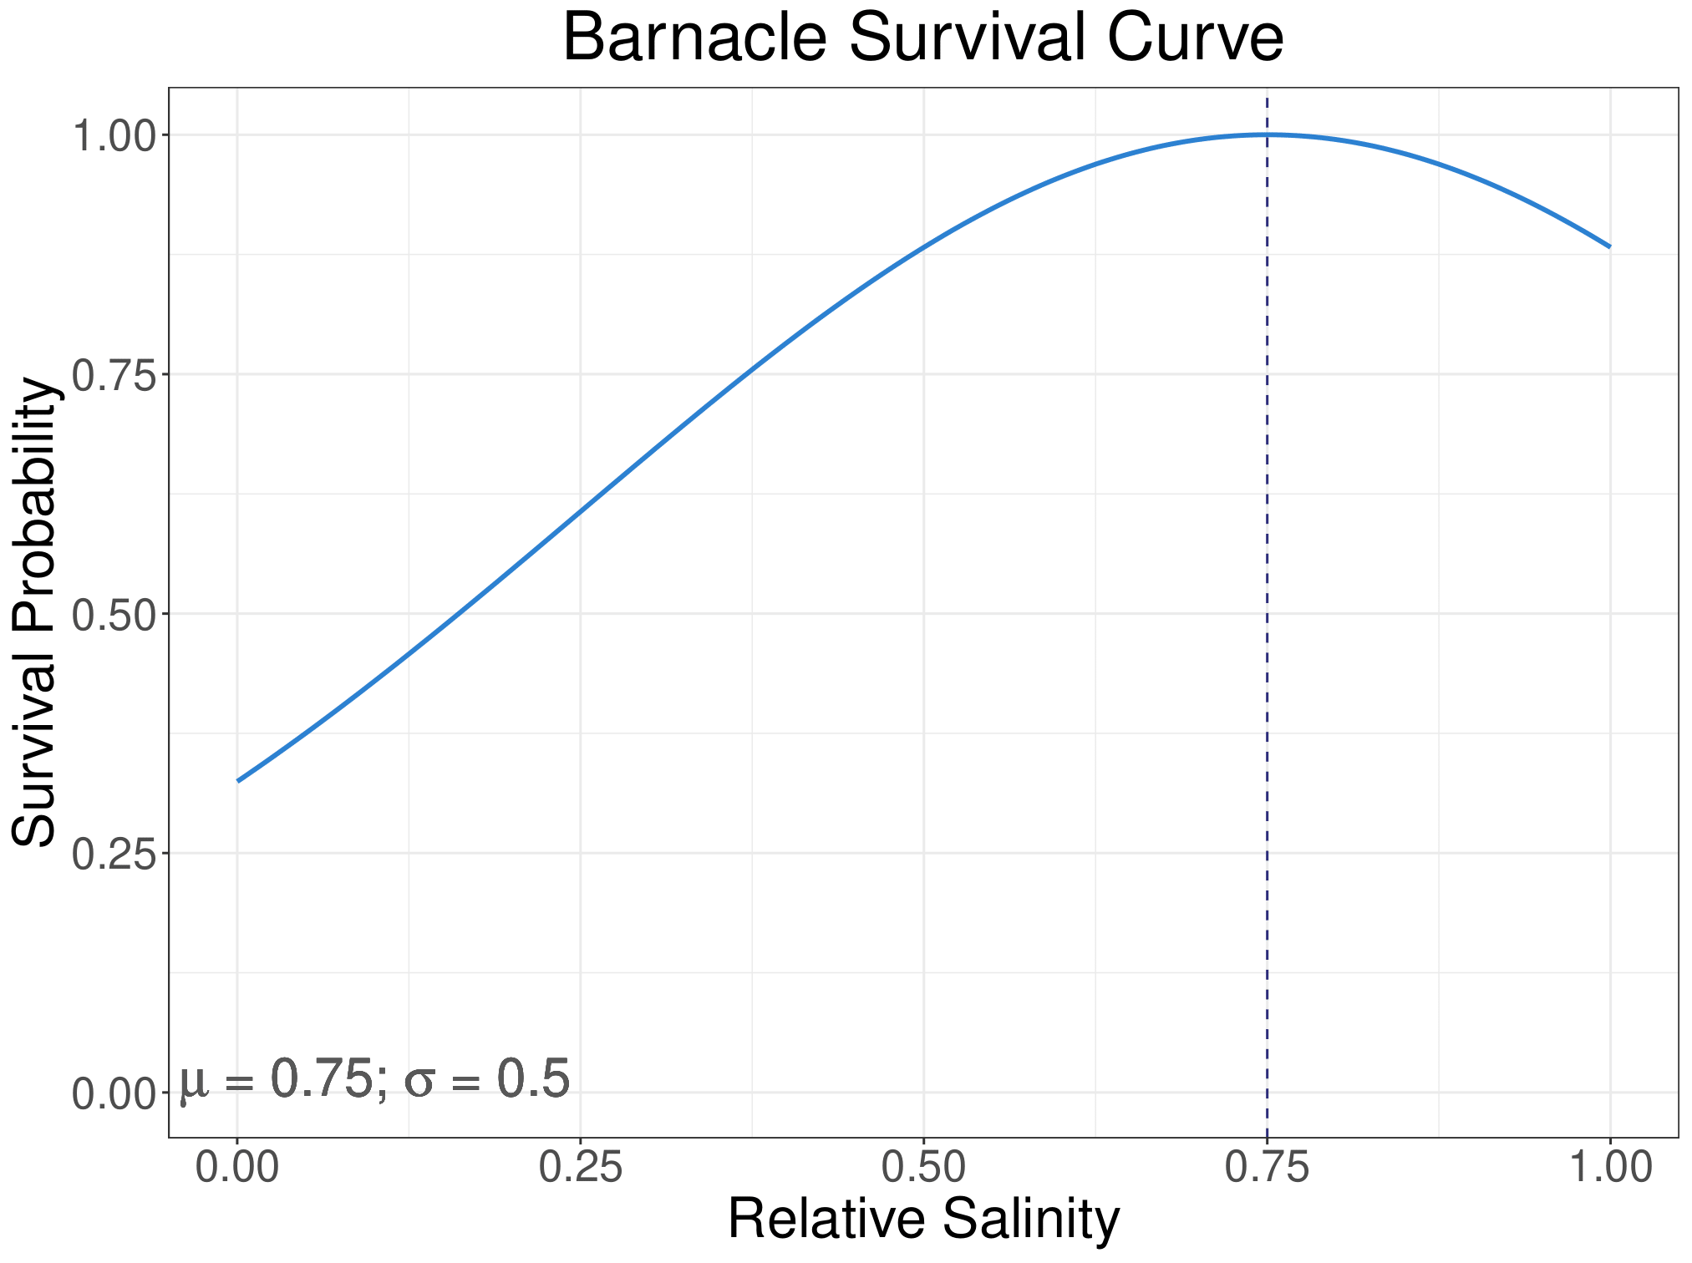
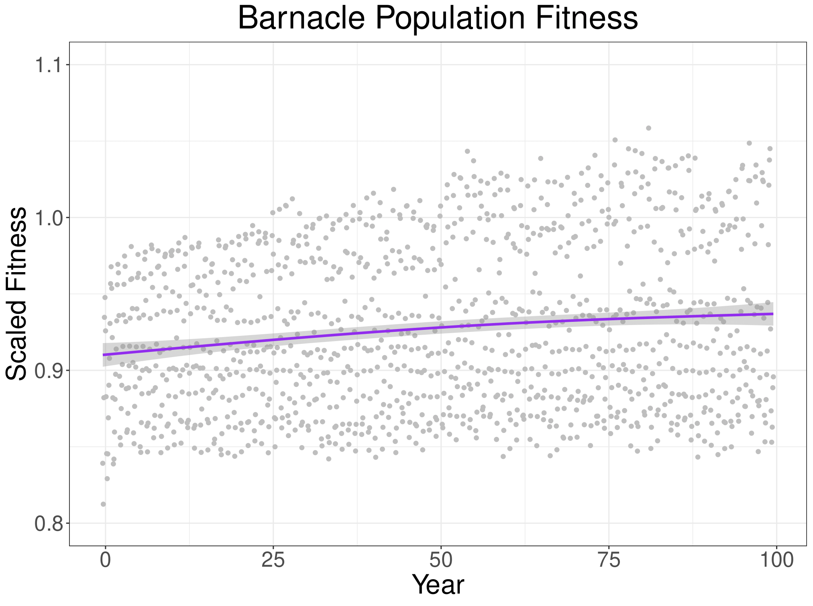
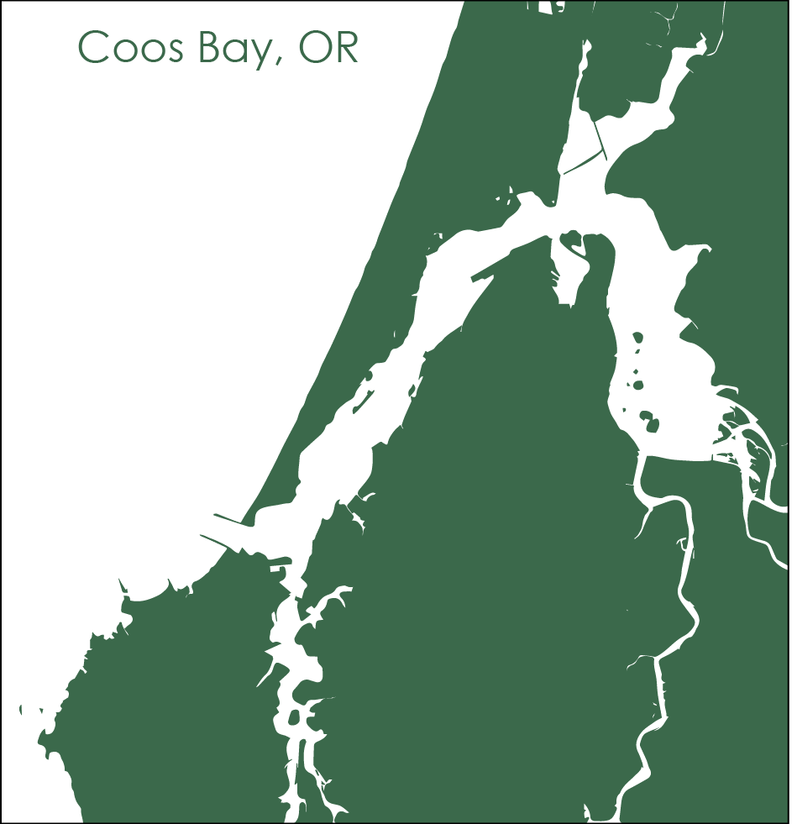


Mar del Plata, Provincia de Buenos Aires, Argentina
What a Load of Barnacles:
A Spatial Population Genomic Simulation Measuring Evolution at Large Scales
Alex Bangs¹, Angel Rivera-Colón¹, Jiseon Min^{1,2}, Peter Ralph^{1,3}
¹ Institute of Ecology and Evolution, University of Oregon, Eugene, Oregon, USA, ²a Department of Mathematics, University of Oregon, Eugene, Oregon, USA
Background
How do we model population genomics for the Pacific acorn barnacle (Balanus glandula)?
Conclusion and Next Steps
What: the Pacific acorn barnacle
Filter-feeding invertebrate found in intertidal zones
Undergoes planktonic larval stage, and sessile juveniles and adult stages
More Environmental Variables
Add other environmental conditions that impact the Pacific acorn barnacle such as temperature and tides
Add seasonal variation of environmental variables
Reproduction and life stages
Brooding occurs seasonally in the late winter, with larvae dispersing during the summer and juveniles settling in the fall
Life Stages
— Larvae | — Juveniles | — Adults | — Total
“We develop computational simulations of biological systems to expand our understanding of population genomics”
“As the sculptor carves a masterpiece out of stone, the computational biologist carves a barnacle out of a blob”
© Martin Arregui
1
Why: The Pacific Coast Range²
Expand the library of biological simulations
Science is a collaborative process, and constructing new simulations involves building off previous work
The variables and scenarios we’ve modeled can be adapted to other biological systems and contribute to our understanding of species otherwise unrelated to the Pacific acorn barnacle.
Greater Biological Scope
Apply model to study the genomic variation of populations across the Pacific coast
Identify what environmental variables are contributing to the population structure
The Effects of Environmental Variables
Juvenile (recently settled) barnacles have higher survival at moderate to high salinities
Adapting to Climate Change
Investigate how changes in ocean temperature and salinity may impact population size, adaptation, and population structure across the native range of the Pacific acorn barnacle
How: SLiM simulation of Coos Bay, OR
SLiM is a software developed by the Messer Lab to build genetically explicit evolutionary models
Scan the QR code to see this project’s GitHub repository
Acknowledgments
Thank you to Erin Jesuit of the VonDassow Lab at OIMB for your help collecting and analyzing B. glandula samples.
To Dave Sutherland for providing environmental models of Coos Bay, OR.
To the Kern Ralph Co-Lab for being a wonderful group to collaborate and learn with.
To Ben Haller and Philipp Messer for the development of SLiM: An Evolutionary Simulation Framework.
To the University of Oregon Summer Program for Undergraduate Research and the Mary G. Alden Fellowship for the funding to pursue summer research.
And to ASM for providing a travel award to attend ABRCMS 2024
Modeling Population Fitness
Density-Dependent Selection, Environmental Gradients, and Local Adaptation impact the fitness of our population
References
1.
iNaturalist community. Observations of Balanus glandula from Mar del Plata, Provincia de Buenos Aires, Argentina observed on Nov 6, 2021. Exported from https://www.inaturalist.org on 11/6/2024
2.
Wares, J. P., Strand, A. E. & Sotka, E. E. Diversity, divergence and density: How habitat and hybrid zone dynamics maintain a genomic cline in an intertidal barnacle. Journal of Biogeography 48, 2174–2185 (2021).
3.
Haller, B. C. & Messer, P. W. SLiM 4: Multispecies Eco-Evolutionary Modeling. The American Naturalist 201, E127–E139 (2023).
4.
Berger, M. S., Darrah, A. J. & Emlet, R. B. Spatial and temporal variability of early post-settlement survivorship and growth in the barnacle Balanus glandula along an estuarine gradient. Journal of Experimental Marine Biology and Ecology 336, 74–87 (2006).
5.
Berger, M. Reproduction of the intertidal barnacle Balanus glandula along an estuarine gradient. Marine Ecology 30, 346–353 (2009).
6.
Conroy, T., Sutherland, D. A. & Ralston, D. K. Estuarine Exchange Flow Variability in a Seasonal, Segmented Estuary. Journal of Physical Oceanography, 50(3), 595-613 50, 595–613 (2020).
7.
Chevy, E. T. et al. Population genetics meets ecology: a guide to individual-based simulations in continuous landscapes. Preprint at https://doi.org/10.1101/2024.07.24.604988 (2024)
Notes:
Judges are looking for
Title, Authors and Institutional Affiliation, Hypothesis/Objective, Background, Methods, Results, Conclusions, Future Work, Bibliography, and Acknowledgments
Top Section: Title, Authors, and Institutional Affiliation
Left Section: Background, Methods (QR code to barnacle sim repository)
Background:
Line about what the Kern-Ralph Co-Lab does
Line about Wares’ work studying the Pacific coast cline
Line about what I have been doing within the Lab
Then what are the barnacles and where are they found
How are we modeling (SLiM)
Mention here’s a QR code to the GitHub repository if anyone wants to look at the nitty-gritty of our work.
Middle Section: Objective, Methods, Results
Objective: Develop model of the Pacific acorn barnacle and biologically-relevant environmental variables that isn’t computationally-expensive
What do we need to implement to accurately model B. glandula
Reproduction and Dispersal based on observations in the area
What biologically-relevant environmental variables do we need to find data for and implement?
Salinity and Temperature
What success have we seen so far?
Modeling variations in reproductive window
Implementing local adaptation
Reproduction
Sexual reproduction with neighbors, producing multiple broods a year
Seasonal brooding occurs in the late winter with larval dispersal occurring after ~4 months, during the summer
Impact of Salinity and Temperature
Current literature suggests juvenile (recently settled) barnacles do best at moderate salinities.
Adult barnacles have higher percent brooding (and thus increased offspring) at lower water temperatures.
Modeling Local Adaptation
B. glandula has limited dispersal capabilities, so populations see greater genomic divergence as the distance between them increases
Right Section: Conclusions, Future Work, Acknowledgements, Bibliography
Conclusion
We’ve successfully modeled the life cycle and reproduction methods of B. glandula
We’ve modeled the effects of biologically-relevant environmental variables on fitness
Developed the platform to conduct research on B. glandula in estuarine settings
Future Work:
Expanding the scope
We can now observe the genomic cline across Pacific acorn barnacle populations
Our future work will involve applying this simulation to other Pacific coast populations to examine the cause of this cline
Examine Climate Change Impacts
Ocean acidification impacts carapace growth
Impacted by changing temperature and Salinity
Very numerous and widespread, good model organism for studying adaptation to changing environments
Acknowledgements:
Thanks to Erin Jesuit at the Oregon Institute for Marine Biology,
Dave Sutherland of the Oceans & Ice Lab
Ben Haller and Philipp Messer for developing SLiM
And the University of Oregon Summer Program for Undergraduate Research and the Mary G. Alden Fellowship for research funding

